Slide 1
Why Haven’t We Stamped Out SQL Injection and XSS Yet?
Romain Gaucher
Coverity
ASEC-F42
Intermediate

Slide 2
About me
Lead security researcher at Coverity
Have spent a fair amount of time on automated analysis of sanitizers, framework analysis, precise remediation advices, context-aware static analysis, etc.
Officer at WASC, contributed to several community projects (Script Mapping, Threat Classification 2, CAPEC, etc.)
Previously at Cigital and NIST
On the web:
Twitter: @rgaucher
Coverity SRL blog: https://communities.coverity.com/blogs/security

Slide 3
Agenda
This talk is not about
what XSS or SQL injection are
how to exploit XSS or SQLi
static analysis heuristics to find these issues
etc.
This talk is about
what developers need to do when they write a web application
importance of understanding SQL and HTML contexts
how these contexts relates to XSS and SQLi
remediation advices we usually hear from security professionals
Notes:
This talk has 3 sections: SQL injection, XSS, and interaction with developers

Slide 4
What we studied (and what we didn’t)
We analyzed 28 Java web applications and 154 versions over time. Most were open source projects. That’s 6MLOC Java and JSP code.
For SQL injection:
focus on queries embedded in applications
we did not analyze the code of stored procedures
For XSS:
focus on server-side pages
most pages have JavaScript but we did not try to understand the impact of JavaScript code (i.e., after it executes)
Notes:
Studied where developers add dynamic data in HTML or SQL

Slide 5
Analyzed projects
These applications used several different control frameworks, such as Spring MVC, Struts, etc.
ORMs such as JPA or Hibernate are used in two-thirds of the applications
All projects had JSP files, but its use is quite different:
One project has 24 lines of JSP, another 84,000
Notes:
Largest application is ~1MLOC, smallest ~10KLOC

Slide 6
Analysis
This research relies heavily on the ability to statically compute contexts for HTML and SQL
We reported the contexts every time some dynamic data is inserted in HTML or SQL (injection site). We do not report the number of possible paths, just injection sites.
Contexts computations
HTML contexts are derived from a HTML5 based parser [1], and simple CSS/JavaScript parsers
SQL contexts are derived from a parser that handles generically SQL, HQL, and JPQL
Limitations
The contexts are computed in the Java program, we do not try to understand how JavaScript impacts the HTML contexts at runtime
Notes:
Computing contexts requires dataflow analysis, and tracking the strings inside the application (concats, mutations, etc.)

Slide 7
Concept of “injection site”
The injection site is our unit for measuring the implicit or explicit string concatenations in a program
We only care and report injection sites that are related to a sub-language we want to analyze: SQL, JPQL, HQL, HTML, JavaScript, and CSS
Example of injection sites related to SQL:
String sql = "select id from users where 1=1";
if (condition1)
sql += " and name='" + user_name + "'";
if (condition2)
sql += " and password=?";
2 injection sites in one SQL query
Notes:
Injection sites is essentially the entire space of eventual string concat w/ a nested language.
The abstract string generated from this query has 4 possible instantiations (based on each conditionals), since we only care about the injection sites, we’d report 2 there. One being the ? (special analysis around it).
We decided to also consider ? as injection sites since, they happen to use a correct API, but they still aimed to add some data in a query.

Slide 8
SQL Injection

Slide 9
The root of all evil
When parameterized queries are used correctly there are no real opportunities for SQL injection
The root of SQL injection therefore is string concatenation of a query string with tainted data
Bright idea: If we could eliminate the habit of developers using string concatenation for queries, we could eliminate SQL injection
Let's examine the "common" security advice given to developers:
“Use an ORM”
“Use parameterized queries”
Notes:
This point is taking out stored procedure.

Slide 10
"Use an ORM"
ORMs are not typically vulnerable to SQLi
Most projects use both ORM and non-ORM
Project ID
SQL | 2 | 4 | 6 | 7 | 9 | 10 | 11 | 13 | 17 | 18 | 20 | 22 | 23 | 24 | 27
JDBC API | ✓ |  | ✓ | ✓ | ✓ | ✓ | ✓ |  |  | ✓ | ✓ | ✓ | ✓ |  | ✓
Hibernate ORM |  |  |  |  |  | ✓ | ✓ |  |  | ✓
Hibernate Non-ORM | ✓ | ✓ |  |  |  | ✓ |  | ✓ | ✓ |  |  |  |  | ✓ | ✓
JPA ORM | ✓ | ✓ | ✓ |  |  |  |  | ✓ |  |  |  |  | ✓ | ✓ | ✓
JPA Non-ORM |  |  | ✓
Notes:
Define ORM here, Object Relation Mapping, practically you use java objects to shadow the DB tables
Columns (JDBC API, etc.)

Slide 11
ORM versus Non-ORM
Overall combination of ORM and non-ORM SQL access
Non-ORM: JDBC, Hibernate SQL / HQL, and JPA JPQL queries
ORM: EntityManager.find(), EntityManager.persist(), Hibernate Criteria, etc.
ORMs are common in our dataset (67%)
Most use JPA, some use Hibernate exclusively
Use of a query language (HQL, SQL, etc.) is common to all projects
SQL accounts for 63% of actual queries
HQL is second, with 31% queries
Conclusion: string-based query construction is still very common in our dataset, even in applications using ORMs.

Slide 12
Eliminate String Concatenation
“Use an ORM”
Projects use a mixture of ORM and query languages. There is a need for query languages!
“Use parameterized queries”

Slide 13
SQL Contexts and Parameterization
Analysis of 985 injection sites, and 545 unique queries (including JDBC, JPA, and Hibernate)
There is an average of 1.8 injection sites per query with a maximum of 22 injection sites in one query.
We identified 10 different SQL contexts
Good: 85% of the injection sites are associated to a SQL context that can be parameterized
Problem: 15% of the queries cannot be parameterized
Notes:
Quickly define SQL contexts here

Slide 14
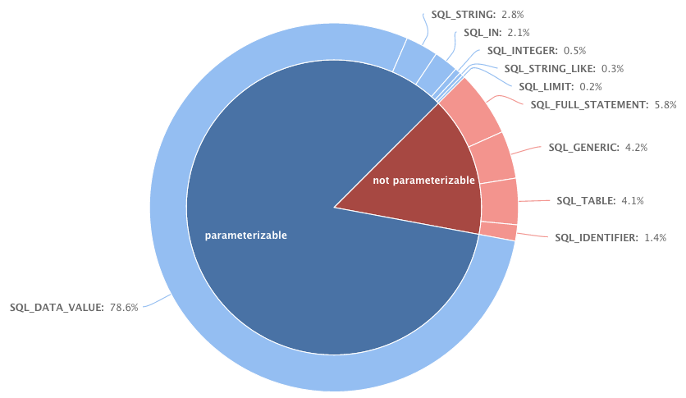
“Use parameterized queries”
Parameterizable vs. Not parameterizable

Slide 15
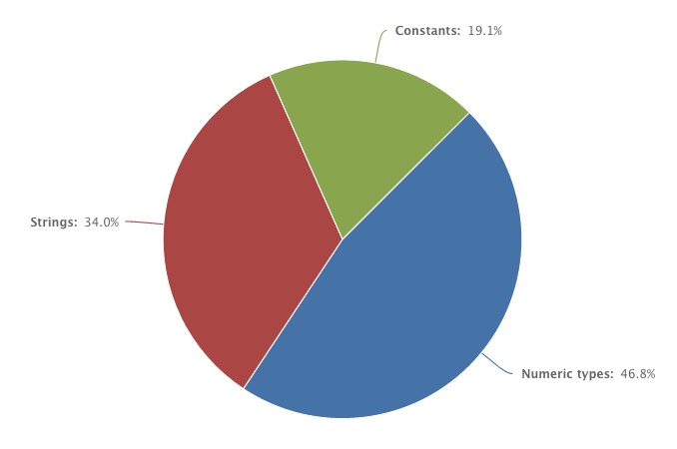
Parameterizable Contexts
Out of the 833 parameterizable contexts, 94% are parameterized
It’s still not perfect; here's the breakdown of the remaining 6% that could be parameterized
Constants: 19%
Constant identifiers
Class names
Strings: 34%
Good ol' strings
Safe types: 47%
Numeric, Date, etc.
Notes:
Interestingly, there is no segmentation of strings and safe types. Looking at some projects specifically, we can clearly see that writing such query is a habit.
Developer sometimes don’t know about parameterized statement and keep using string concats

Slide 16
Non-Parameterizable Contexts
SQL_FULL_STATEMENT (5.8%): the entire SQL query is not resolvable statically (DB, SQL file, configuration files, user, etc.)
It’s not a “real” context and most likely a design decision
For web requests, they should have anti-CSRF and access controls in place
SQL_TABLE (4.1%): table name
SQL_IDENTIFIER (1.4%): column name or a variable
SQL_GENERIC (4.2%): keyword, etc.
Notes:
9% are the queries that contain one injection site that could be parameterized but isn’t
SQL_GENERIC: everything that does not belong to the previous contexts (which we did not find so interesting to group)

Slide 17
Parameterize This!
Table name:
stmt1= c.createStatement();
stmt1.execute("TRUNCATE TABLE `"+ table + "`");
Trigger name:
Statement st = conn.createStatement();
schema = StringUtils.quoteIdentifier(schema);
String trigger = schema + '.'
+ StringUtils.quoteIdentifier(PREFIX + table);
st.execute("DROP TRIGGER IF EXISTS " + trigger);
Conclusion: developers still need to concatenate in some queries.
Notes:
SQL/HQL/SQL

Slide 18
Eliminate String Concatenation
“Use an ORM”
Projects use a mixture of ORM and non-ORM SQL technologies. There is a need for query languages.
“Use parameterized queries”
15% of injection sites cannot be parameterized
There's hope, most parameterizable ones are parameterized (94%)!
2% of parameterizable injection sites use dynamic strings that aren't parameterized; opportunity for SQL injection

Slide 19
Now What?
String concatenation cannot easily be eliminated
How can its effects be mitigated?
Let's examine some other "common" security advice:
“Do input validation”
“Escape special characters”

Slide 20
“Do Input Validation”
Input validation = “Security through serendipity”
Does the domain of valid input values happens to preclude security problems for all contexts where the data is used? Not necessarily.
The input validation of data should be dictated by the functional requirements of the application, not by the security obligations of SQL contexts.
“Why can’t my password contain % ?”
“Why can’t Miles O’Brien create a profile?”
Conclusion: you happen to be safe sometimes, you just cannot guarantee it throughout the application.

Slide 21
Mitigate String Concatenation
“Do input validation”
Different contexts have different security obligations
Functional requirements should drive input validation
“Sanitize special characters”

Slide 22
Sanitize special characters
What's a special character? Different dialects have different requirements.
Does \ escaping work for default PostgreSQL >= 9.1?
What needs escaping in a quoted identifier?
Escapers might be useful in a special case where the application is doing a lot of dynamic queries and parameterization would require large scale refactoring.
Not all contexts can use an escaper. Some characters just need to be filtered out.
Notes:
PostgreSQL 9.1 by default sets standard_conforming_strings to 'on'. When set, only the PostgreSQL special "escape string constants", denoted with an "E" in front of the string like E'foobar', honors a backslash escape. Otherwise, normal string constants treat a backslash as a normal character.
Quoted identifier can have anything, even double quotes. The double quotes just need to be doubled up to be escaped. Some dialects support a backtick also as a quote.

Slide 23
Mitigate String Concatenation
“Do input validation”
Different contexts have different security obligations
Application requirements should drive input validation
“Sanitize special characters”
Different dialects have different requirements
Can be applied incorrectly

Slide 24
SQL Conclusions
String concatenation cannot be eradicated from SQL queries.
Input validation may not be adequate, sanitizers can help but can also hinder.
Security ought to provide developers helpful advice:
Code, code, code…
Specific to a technology (JDBC, Hibernate HQL, etc.)
And specific to a context (table name, IN clause, etc.)
Working with developers to build this kind of documentation for your organization’s specific use of technologies and query styles will help reduce SQL injection defects.

Slide 25
Cross-Site Scripting

Slide 26
XSS is confusing
From a code perspective, XSS isn’t a single vulnerability. It’s a group of vulnerabilities that mostly involve injection of tainted data into various HTML contexts.
There is no one way to fix all XSS vulnerabilities with one magic “cleansing function”. Developers really need to understand this.
Let's examine the "common" security advices given to developers:
“Use HTML escaping”
“Don’t insert user data in <random HTML location here>”
“Use auto-escaping template engines”
Notes:
Mostly inj in different HTML contexts because flash, etc. aren’t really about HTML contexts

Slide 27
“Use HTML escaping”
HTML entity escaping can be used in several locations in an HTML document
It can be used when the web browser will be able to process the HTML entities. For example, it is correct for the value of a <div> or an HTML attribute.
However, HTML escaping cannot be used in in all cases: you wouldn’t escape an attribute name, or the content of a <style>
To better understand when we can use this HTML escaper and when we cannot, we need to talk about HTML contexts
Notes:
Usually -> in XHTML applications, it is possible to HTML escape most of the content

Slide 28
HTML Contexts?
No documentation really describes what HTML contexts are or gives an good list of them
Practically, many places in an HTML page (inc. CSS, JS, etc.) have the same security obligation. These are the HTML contexts.
Simple example, double quoted HTML attribute value
<div id="${inj_var}">… <pre class="${inj_var}">…
Some of the contexts:
JavaScript string, HTML tag name, HTML attribute name, CSS string, CSS code, JavaScript code, HTML RCDATA, HTML PCDATA, HTML script tag body, URL, etc.
Notes:
Not one place to look for security obligations for HTML contexts.
- HTML related: html5 tokenizer spec and html4 spec
- JavaScript grammars
- CSS grammars
Then, need to integrate some quirks? How to capture the behaviors from browsers… it’s fairly tough; we cannot have an exhaustive list of behaviors
What happens is that ${inj_var} has the same security constraints:
- cannot contain a “
- the behavior is that the web browser will HTML decode the content of foo or bar before processing them (if it does)

Slide 29
The joy of nested contexts
<a href="javascript:hello('${inj_var}')">
HTML Contexts Stack
Single quoted JavaScript string
JavaScript code
URI
Double quoted HTML attribute value
Single Quoted JavaScript String
JavaScript Code
URI
Double Quoted HTML Attribute Value
Simplified: Our data is inserted inside a JavaScript String inside a URI inside an HTML attribute
We’ll note: HTML Attribute -> URI -> JS String

Slide 30
The joy of nested contexts
<a href="javascript:hello('${inj_var}')">
stack := {HTML Attribute -> URI -> JS String}
The web browser will:
Take the content of the attribute href and HTML decode it
Analyze the URI and recognize the javascript: scheme
Take the content of the URI (i.e., after the scheme) and URL decode it
Since it’s supposed to be JavaScript, the extracted content hello('${inj_var}') is sent to the JS engine for rendering
The JS engine will parse the program and especially the string that contains our ${inj_var} by doing a JS string decoding
Based on this flow we know what needs to be done to make a safe insertion for ${inj_var} in this context
Notes:
Look back at the example: <a href="javascript:hello('${inj_var}')”>
What do we need to do to fix an issue in that nested contexts?
-> JS string escaping
-> URI encoding
-> HTML escaping
No need to worry about specific injections in a URI contexts (scheme issue) here…

Slide 31
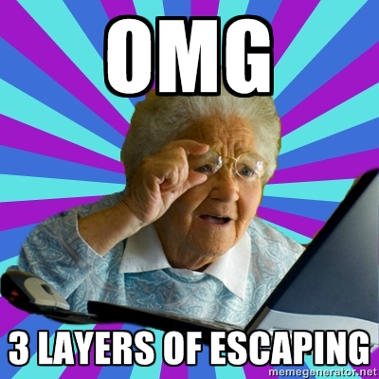
Well put grand’ma!
Notes:
JavaScript string escaping
URL encoding
HTML escaping

Slide 32
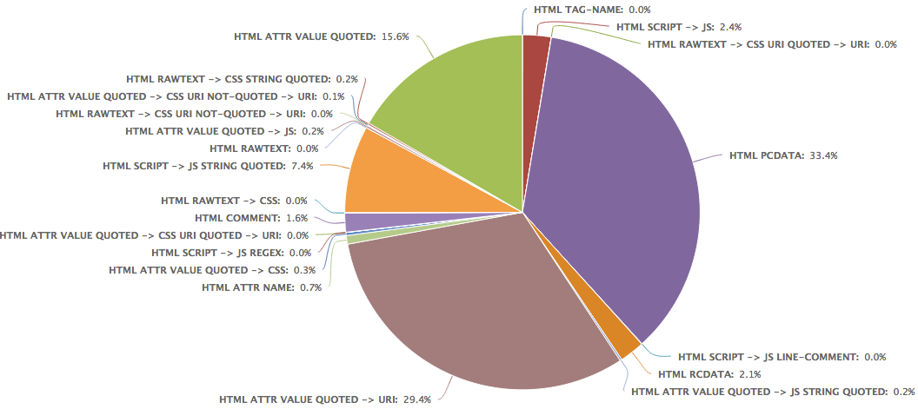
Distribution of HTML contexts
Notes:
We analyzed more than 20K injection sites for HTML which cover 26 different stacks of HTML contexts
We found context stacks with up to 3 elements in out dataset, and more than 45% of the context stacks have 2 contexts

Slide 33
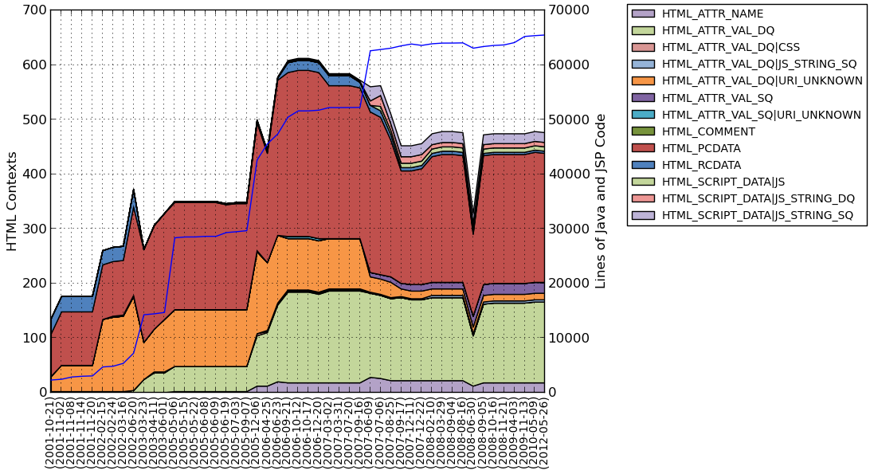
HTML contexts matters more now!
Notes:
This is an example of a project we analyzed overtime. For each revision, we looked at the distribution of HTML contexts, and plotted this area graph.
We can clearly see the increasing number of diversity of contexts in the application.

Slide 34
Fix XSS
“Use HTML escaping”
Projects are using a lot of different HTML contexts, and it’s not getting better
“Don’t insert user data in <insert HTML location here>”
“Use auto-escaping template engines”

Slide 35
Focusing on the HTML escaping…
HTML escaping is important and can be correctly used in 50% of the injection sites
In addition, it makes safe 70% of them when implemented correctly (but makes the data incorrect)
However, let’s look at the different implementations of HTML escapers

Slide 36
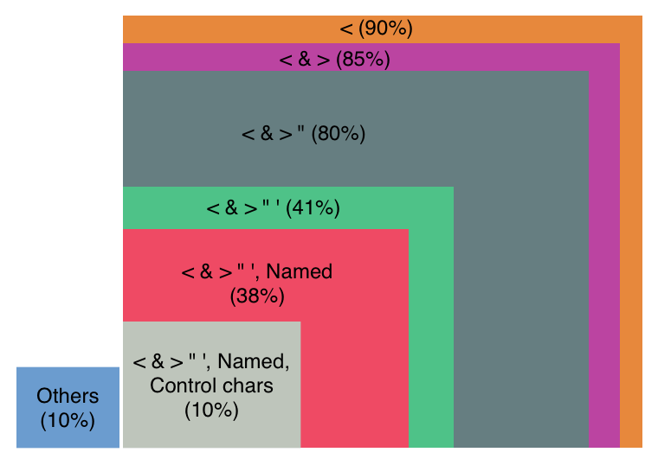
Dive into HTML escapers…
HTML escaping should be simple
We found 76 different HTML escapers in our dataset
Most of them belong to a framework/library used by the application
In average, a project has 5.7 HTML escapers
All HTML escapers are
not equivalent…
Notes:
I doubt we can talk about a reference implementation, but we developed on that works for HTML normal elements and HTML attributes, available in the coverity security library
Some escapers detected as HTML escapers are XML escapers and might have a very limited scope… this might biased the data
Example of implementations:
- ESAPI has 2 (attr and normal elements)

Slide 37
Fix XSS
“Use HTML escaping”
Projects are using a lot of different HTML contexts, and it’s not getting better
HTML escaping seems to mean a lot of different things… Only 41% of the implementations seems sufficient
“Don’t insert user data in <insert HTML location here>”
“Use auto-escaping template engines”

Slide 38
“Don’t insert data into <?>”
We found that many security guidances just say “don’t do this”
OWASP XSS cheat sheet [2] has the following rule:
Never put data HERE | “Context” name
<script>...HERE...</script> | Directly in script
<!--...HERE...--> | HTML comment
<div ...HERE...=test /> | Attribute name
<HERE... href="/test" /> | Tag name
<style>...HERE...</style> | Directly in CSS

Slide 39
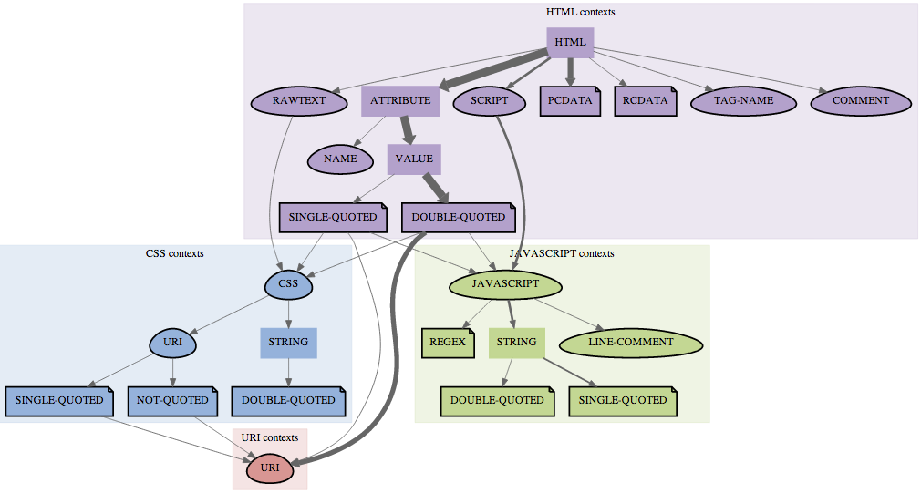
Observed HTML contexts and nesting
Notes:
Border: terminal node for the generated strings (e.g., there is an output in that context)
Egg shape: some kind of filtering is required
Page shape: escaping is possible
Flow := combination of nested contexts, each remediation requirement should be met in order
This representation has several limitations; a “real” representations of the contexts would be a graph with cycles (e.g., JS STRING contains HTML that can contains JS …)

Slide 40
Observed HTML contexts and nesting
Notes:
Border: terminal node for the generated strings (e.g., there is an output in that context)
Egg shape: some kind of filtering is required
Page shape: escaping is possible
Flow := combination of nested contexts, each remediation requirement should be met in order
This representation has several limitations; a “real” representations of the contexts would be a graph with cycles (e.g., JS STRING contains HTML that can contains JS …)

Slide 41
Fix XSS
“Use HTML escaping”
Projects are using a many different HTML contexts, and it’s not getting better
HTML escaping seems to mean a lot of different things… Only 41% of the implementations seems sufficient
“Don’t insert user data in <insert HTML location here>”
Developers need to add data into many HTML contexts
“Use auto-escaping template engines”

Slide 42
Auto-escaping template libraries
A good trend with template engines is to provide auto-escaping.
Auto-escaping means that the engine will take the dynamic data and escape it without any directive from the developer.
Such reasoning is great and clearly makes a typical web application more secure.
However, do they understand the contexts and provide the required escaping/filtering to be safe for XSS?

Slide 43
Auto-escaping template libraries
Some don’t even escape ‘ properly
Only GCT provides a fairly good context aware auto-escaping, others essentially perform HTML escaping all the time
Notes:
HTML escaping all the time is a false sense of security. It’s not correct all time
GCT (google closure template) caveat: bad handling of URI, injection in href=“javascript:<HERE>” won’t be dealt with, etc. It’s tough to write a HTML context parser!
Note that OWASP seems to have one (owasp-jxt), but no update since 2011

Slide 44
Fix XSS
“Use HTML escaping”
Projects are using a lot of different HTML contexts, and it’s not getting better
HTML escaping seems to mean a lot of different things… Only 41% of the implementations we saw seems sufficient
“Don’t insert user data in <insert HTML location here>”
Developers need to add data into many HTML contexts
“Use auto-escaping template engines”
Sometimes a false sense of security

Slide 45
Sad truth about XSS
I’m not saying that we have been all wrong until now. We just need to come up with a more complete solution for XSS:
Sadly, there is no one silver bullet for XSS
We cannot rely on one escaping function or filter
We cannot rely yet only on most auto-escaping template engines
For the time being, we need:
Libraries that allow developer to escape the data properly for many contexts, and filter the data when an escaper cannot be used
Give actionable guidance to the developers

Slide 46
Escapers should be available
List of required escapers based on our dataset:
HTML escaping (^85%)
URI encoding (^30%)
JavaScript string escaping (^13%)
CSS string escaping (^0.16%)
JavaScript regex escaping (^0.01%)
Libraries like OWASP ESAPI [3] or Coverity Security Library [4] already have these escapers; promote them!
Notes:
^ : at most – escapers percentage are computed based on the distribution of context.
We split the context stacks and resolve all necessary sanitizers based on the individual contexts

Slide 47
Filters should be available
HTML contexts that require a filter based on our dataset:
HTML Attribute -> URI (^30%)
HTML Attribute -> JS code (0.2%)
HTML Attribute -> CSS (0.3%)
Etc.
How to handle URIs?
Filter the scheme to make sure you allow it (http, https, etc.)
Make sure the authority makes sense for your application
URI encode each element of the path
URI encode query string parameter names and values
ESAPI has a isValidURL which seems very restrictive, and CSL asUrl rewrites the URL to make it safe (but you need to manually encode the params & paths)
Notes:
Filters are to be used when an escaper cannot be.

Slide 48
XSS Conclusions
XSS is complex because it can happen in many different locations in the HTML pages (HTML contexts).
Input validation may not be adequate
Sanitizers can help but it’s very difficult to find a complete library for XSS
OWASP XSS cheat sheet is a good start, but I believe we should do more:
We started blogging [5] about these kind of issues and will continue doing it as we improve our technologies or just come across “interesting stuff”
We will also continue to improve CSL [4] by adding filters, etc.
We need to be more serious about raising awareness of HTML contexts

Slide 49
Developers need some <3

Slide 50
What’s up with developers?!
It’s getting better. More and more developers have a basic understanding of security issues like XSS and SQLi.
For SQL, developers parameterized 94% of the time when possible
For HTML, we see many places where HTML escaping is used
But it’s just too complex and convoluted for them to understand everything
Security obligations of each context
Nested contexts and ordering of escapers
There are gaps in the way security information is presented online; StackOverflow is a scary place. However, if you don't give them advice, who will?
Notes:
StackOverflow is becoming the most important resource for developers.

Slide 51
Ways forward
Focus developer communication on the code point of view, as opposed to the attacker’s point of view:
Attacks and threats are the "why" we need to fix
Developers need the "how" and "where" to fix
Provide helpful advice:
Actionable (i.e. code, code, and more code)
To a specific technology (JSTL, Hibernate HQL, jQuery, etc.)
In a specific context or contexts (IN clause, URI, CSS string, etc.)
What does helpful advice look like?
Not this: "Parameterized all SQL statements."
How about this?

Slide 52
Helpful Advice
How to Parameterize Data Values Example: "SELECT * FROM table WHERE name = '" + userName + "'"
JDBC | String paramQuery = "SELECT * FROM table WHERE name = ?"; PreparedStatement prepStmt = connection.prepareStatement(paramQuery); prepStmt.setString(1, userName);
Hibernate Native Query | String paramQuery = "SELECT * FROM table WHERE name = :username"; SQLQuery query = session.createSQLQuery(paramQuery); query.setParameter("username", userName);
JPA Native Query | String paramQuery = "SELECT * FROM table WHERE name = :username"; Query query = entityManager.createNativeQuery(paramQuery); query.setParameter("username", userName);
Notes:
Advices need to be tailored based on what’s used in the application.

Slide 53
Helpful Advice
How to add data in a CSS string within a CSS block using CSL. Provide several examples that show the common usages for different HTML contexts, and technologies your developers are using
Expression Language | <style> a[href *= "${cov:cssStringEscape(param.foobar)}"] { background-color: pink!important; } </style>
Java or JSP Scriptlet | <style> <% String parm = request.getParameter("foobar"); String cssEscaped = Escape.cssString(parm); %> a[href *= "<%= cssEscaped %>"] { background-color: pink!important; } </style>
Notes:
In this context RAWTEXT -> CSS STRING, (nested context), we designed the escaper to behave that way:
- Ensure that the literal </style> cannot be part of the string (otherwise, closes the <style>)
- The string cannot be escaped from by either closing the quote, or generating a parse error from the CSS parser (which will try to recover from it and can create a CSS injection condition)

Slide 54
Conclusions
XSS and SQLi can be nuanced and complex. XSS is actually becoming more and more complex over time as the number of contexts and nesting increases.
Current advices we saw are either:
Generic remediation
Precisely how to perform the attack
Guidance needs to be both more specific and technical, yet also simpler and shorter. The only way to get that is to take tailored, detailed advice and crop it down for the development team’s needs.
Remember: your developers need some <3
Notes:
Current advices are not really targeting the developers; they need more precise stuff based on the languages, frameworks, libs they’re using…

Slide 55
Questions?

Slide 56
References
[1] HTML 5 tokenizer specification
[2] OWASP XSS Cheat Sheet
[3] OWASP ESAPI Java
[4] Coverity Security Library Java
[5] Coverity Security Research Blog
[6] OWASP SQLi Prevention Cheat Sheet

